Slide 1
ART & AESTHETICS
LECTURE: 01

Slide 2
WHAT IS ART?
DEFINITION OF ART:
“The expression or application of human creative skill and imagination, typically in a visual form such as Painting or Sculpture, Calligraphy, Textile, Graphics, Dance.”

Slide 3
INTRODUCTION
Art is strictly a human phenomenon.
No definitions are universal, timeless, and absolute.
Art is primarily visual medium that is used to express ideas about our human experience and the world around us.

Slide 4
To get a better idea of what art is and how to create it, we will center our inquiry on four major areas:
1. FUNCTION (purpose/mission)
2. VISUAL FORM
3. CONTENT (subject matter/material)
4. AESTHETICS (appreciation of beauty)

Slide 5
1.FUNCTION
Art functions.
Art promotes our spiritual or physical well-being.
Art communicates thoughts, ideas, and emotions.
Art glorifies the power of the state and its rulers.

Slide 6
Art celebrates war and conquest, and sometimes peace.
Art is a mean for protesting political and social injustice.
Art educates us about ourselves and the world around us.
Art entertains.
Of course, music, dance or literature does similar things and functions.

Slide 7
2. VISUAL FORMS
Art has a visual form, which includes:
The elements from which the artwork is made.
Its formal elements, such as line, shape, form, texture, value, color, space, and so on.
Its overall composition, its size, its internal balance and so on.

Slide 8
3. CONTENT
Art has content, which is the mass of ideas associated with an art work and communicated through the following:
The art’s imagery.
Its surroundings where it is used or displayed.
Its symbolic meaning.

Slide 9
4. AESTHETICS
Aesthetics is a branch of Philosophy that deals with the beauty, appreciation and judgement regarding what is art.
It is an ability to appreciate/ judge beauty.
The sense concerned with artistic pleasure.
An artwork which is designed to give pleasure through beauty has aesthetics.
Art itself is an aesthetic experience.
“Beauty lies in the eye of the beholder”(Plato)

Slide 10
Why study the World of Art?
We study art because it is among the highest expressions of culture.
The “world of art” is composed of objects from many, many cultures__ as many cultures as there are and have been.
In fact, from culture to culture, and from cultural era, the very idea of what “art” even is has changed.

Slide 11
“Art is an expression of inner most thoughts, feelings and creativity in any medium or form.”
Art has many dimensions.
Art is also a source of communication.
Dot to line, lines to shape and form

Slide 12
Visual Arts_____ Painting, sculpture, architecture, Textiles, Ceramics, Furniture, Interior Design, Calligraphy, Metalwork and Jewellary.
Performing Arts (Theater, Dance, Puppetry, Music, Film)

Slide 13
INTER LINKAGES AMONG ART FORMS
All Art forms are inter related/interlinked.
Inspired, influenced and transformed by and with each other due to its shapes, forms, design & motifs.
Designs and forms are connected and adapted from culture to culture, object to object and nature.

Slide 14
How this circular design and shape are interlinked
Niche from Graveyard, Sindh
Traditional Jewellary

Slide 15
Wood work of Chiniot
Graveyard , Makli Sindh

Slide 16
Transformation of Circular design in different medium and form
Painted Pottery , Multan
Mausoleum of Jam Tamachi at Sindh

Slide 17
These designs are been used now in Textile, Ceramics and Visual Arts
Tiles, Makli (Sindh)
Calligraphic manuscripts

Slide 18
Gold wall Painting
Kundan Jewellary

Slide 19
Painted Ceiling & Jewelry

Slide 21
Miniature painting and Mural painting

Slide 22
Chinioti Furniture
Interior Painted wall at
Sadiq Garh Palace- Bahawalpur

Slide 23
Calligraphic manuscripts & illuminations

Slide 24
Tiles | Origin: Turkey, Iznik, Ottoman | Period: last quarter of the 16th centur
Two Tiles | Origin: Syria | Period: 17th century

Slide 25
Transformation and connections of dome like form in architecture and furniture
Chinioti Furniture
Wooden Door, Darawar Fort

Slide 26
Transformation of Paisley design

Slide 27
Wooden carving for Block Printing & Mehndi Design: The application of Paisley Design

Slide 29
transformation of Colors and traditional designs

Slide 30
Shapes of domes and earrings

Slide 33
Interlinked form of dome like designs
Jhumka Earrings
Dome of Mosque

Slide 34
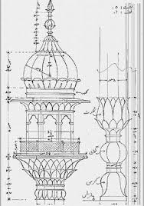
Stupa, Gandhara

Slide 35
Transformation of traditional designs

Slide 36
Intermingled designs of Jalis
Wooden Furniture
Shah Jahani Mosque Thatta, Sindh

Slide 37
Transformation of the Jali motif in jewelry and textile

Slide 38
how these Design of Jalis are been used in Calligraphic Manuscripts, Ceramics, Textile and Jewellary.
Collection of Turkish art, Los Angeles. Calligraphic manuscripts
Vessel | Origin: Iraq or Syria | Period: 1000-1250

Slide 39
Jar Filter Western or Central Asia Jar Filter Ceramic; Vessel, Terracotta, Height: 7/16 in. (1.1 cm); Diameter: 2 9/16 in. (6.5 cm) Gift of Jerome F. Snyder (M.80.202.227) Art of the Middle East: Islamic Department.
Jar Filter Western or Central Asia Jar Filter Ceramic; Vessel, Terracotta, Height: 1 3/8 in. (3.5 cm); Diameter: 2 3/4 in. (7 cm) Gift of Jerome F. Snyder (M.80.202.230) Art of the Middle East: Islamic Department.

Slide 41
Persian manuscript
Delhi First Mosque Quwat ul Islam, Wall decor

Slide 42
Mughal Special Design of carpet
Mughal Design

Slide 44
Interlinked Border designs in textile and manuscripts

Slide 45
Textile designs and carpet weaving

Slide 49
Embroidery motifs

Slide 51
Transformation of Floral Motifs in Hashiyas and Textiles

Slide 52
Miniature Hashiya
Carpet Border

Slide 54
Fauna motifs

Slide 55
Tile work at Uchh Sharif
Multani Pottery

Slide 56
Tile Work
Painted Mural at Sadiq Garh Palace, Bhawalpur

Slide 57
Ruined Tile Work at Makli, Sindh
Ceramic Pottery

Slide 58
Inside Dome, Thatta Mosque, Pakistan
Geometrical Pattern

Slide 59
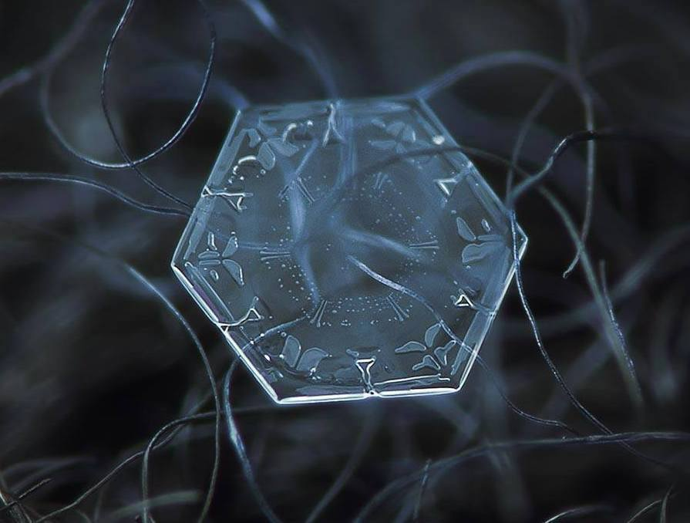
Nature’s Art
Followed in Human created Art

Slide 60
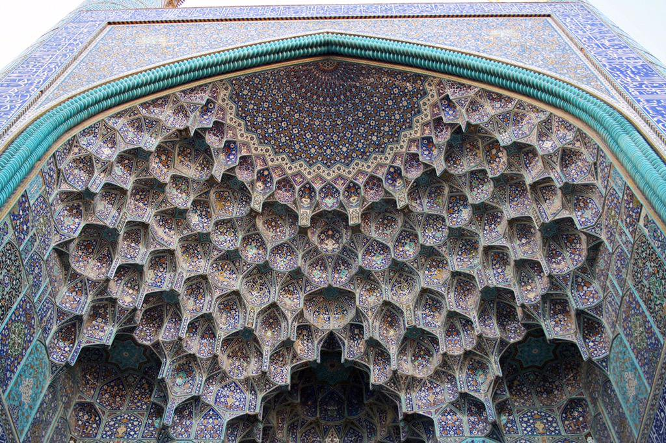
Honeycomb Design applied in Muqarnas vaulting in Muslim Architecture.
Sheikh Lotfollah Mosque, Isfahan, 1603–1619
Hexagonal wax cells built by honey bees.

Slide 61
Composition
Segregation

Slide 62
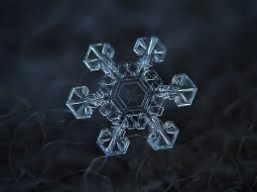
Nature’s Inspirations

Slide 63
Reproduction: (Japan)
Innovation

Slide 64
Geometrical Design
Geometrical Design, Alhambra, Granada, Spain

Slide 65
Dome: Taj Mehal

Slide 66
Geometrical Design, Alhambra, Granada, Spain
Calligraphic Geometrical Design, Turkey

Slide 67
Square Kufic Calligraphy
Graphical Image

Slide 68
Floral Designs dominating the color Blue, Wazir Kahn Mosque, Lahore
Shrine of Shah Rukn e Alam, Multan

Slide 69
From Tradition to Modern
or contemporary

